Slide 1


E-Commerce Sales Dashboard
Made by: SUDHANSHI

Slide 2

OBJECTIVE
The Sales team of an E-Commerce Company wants to design a Sales Dashboard to analyze the sales based on various product categories. The Company wants to add user control for product category, so users can select a category and can see the trend month-wise and product-wise category accordingly.
The Sales team also wants to create a histogram to analyze number of shipping days.

Slide 3
Table of Contents
Understanding Dashboard
Loading Raw Data into SSMS (Sql Server Management System)
Query to create a Table with Raw Data
Query to create a shipping days bins of total orders shipped
Upload csv file into Power BI tool
Create a relationship between customers, shipping, order details and products table
Use cards to show category-wise Total Sales ,Quantity and Profit
Create Stacked bar chart to know region wise sales
Create Matrix to know how frequently customer purchase our product
Create Donut pie chart to know which country we should increase our sales.

Slide 4
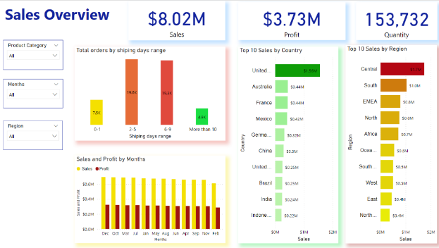
Understanding Dashboard
A dashboard is a very helpful tool that brings together all the data in the form of charts, graphs, histogram ,statistics, and many more visualizations which lead to data-driven decision making. Dashboard contain actionable data. By looking at this data an organization can make key business decisions on the go.

Slide 5
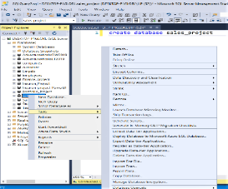
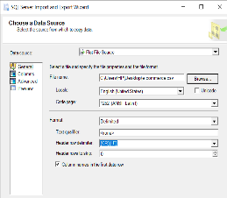
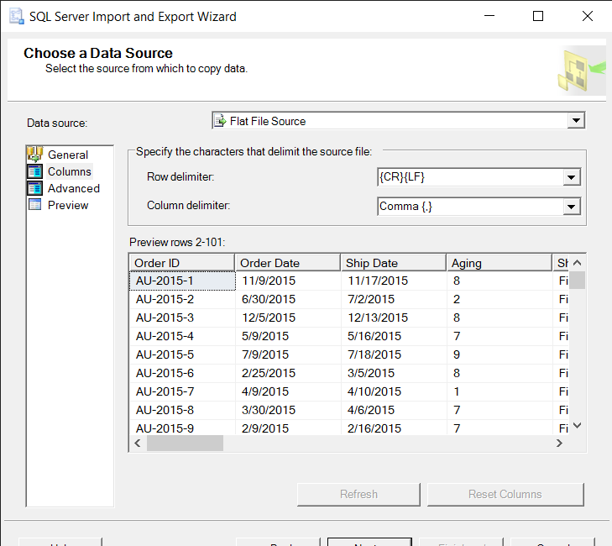
Loading Data in SSMS
This Data is provided by Ineuron Company.
Dataset is already cleaned so we just upload our dataset in SSMS Tool.
Write a query to create database
Create database sales_project
Step 1:Right click on sales_project database
Step 2: Click on Tasks then Import data
Step 3: Choose Flat file source then choose e-commerce csv file.
Step 4: Press next and then Run immediately

Slide 6
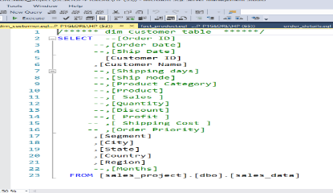
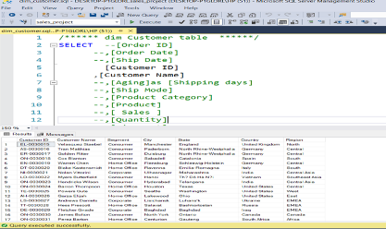
Create Customer Table with Raw Data
This is my dimension table.
For Creating Customer table, I choose various columns which is related to customer details like Customer Id ,Customer Name, Segment, City, State, Country and Region
In Customer table Customer ID works as a primary key.

Slide 7
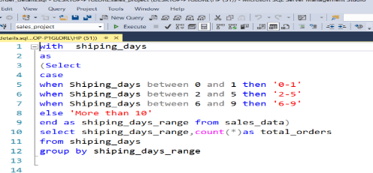
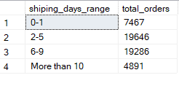
Create Shipping days bins
This is the order details table.
I create a bins with the help of shipping days column to know how many order delivered in 0-1 shipping days and so on.
For creating a bins, I applied case statement with Common Table Expression(CTE).
Case statement: Case statement in SQL returns a value on a specified condition.

Slide 8
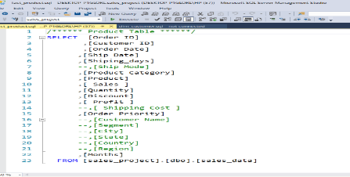
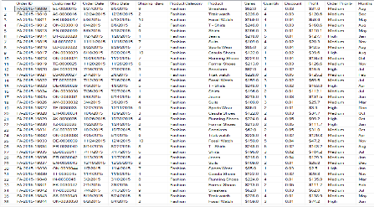
Create Product Table
This is my fact table where I put all the foreign keys and all the measuring attributes of dimension table.
For creating a product table I choose all the measuring attributes, foreign key and product related details like :
Foreign key: Order ID, Customer ID, Shiping_days
Measuring attributes: Sales, Quantity, Discount, Profit
Product and Order related attributes: Product, Product category, Order date, Ship date, Order priority , Months

Slide 9
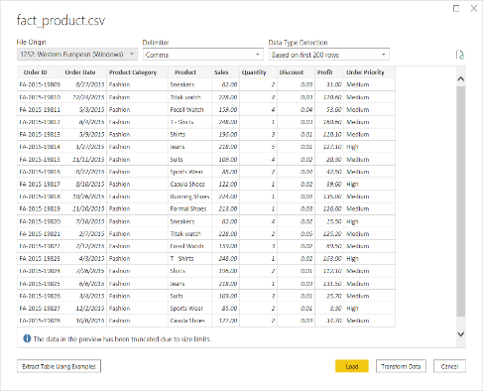
Upload file into PowerBI
We can get Data from any of the data source in PowerBI by selecting Get Data.
Step 1:Click on Get Data
Step 2: Choose Text/CSV file
Step 3: Load fact_product csv file in PowerBi

Slide 10
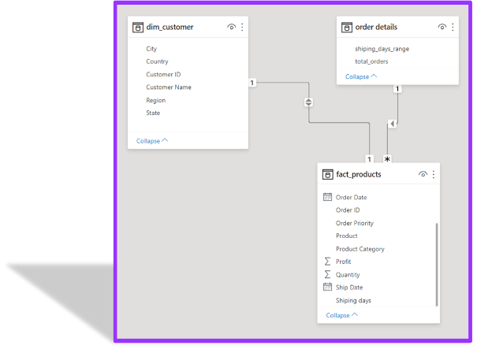
Create Relationships between Tables
To make a relationship between dim_customer entity and fact_products entity. I used One to One relationship with the help of a common element which is Customer ID.
Order details entity is our sql query so I made a relationship of many to one and I used common element of Shipping days.

Slide 11
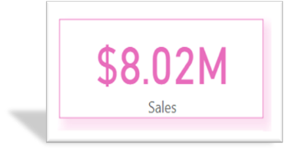
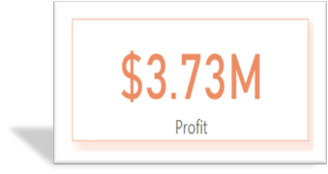
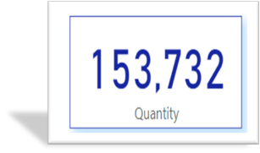
Create Card Visualization
Step 1: Choose card from Visualization Pane
Step 2:Drag Quantity column to fields
Step 3: In Format tab go to Display units then change Auto to None

Slide 12
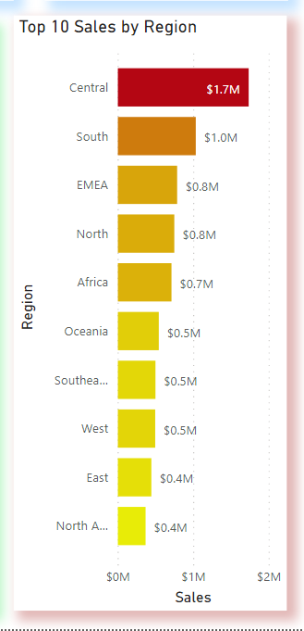
Create Stacked Bar Chart
Step 1: Go to fields
Step 2: Put Region column in Axis
Step 3: Put sales column then click on downward key and select sum on Value option.
Step 4: Go to Format tab, Change Data color by color scale.
Step 5: Applied filters to know Top 10 regions where we do maximum sales.

Slide 13
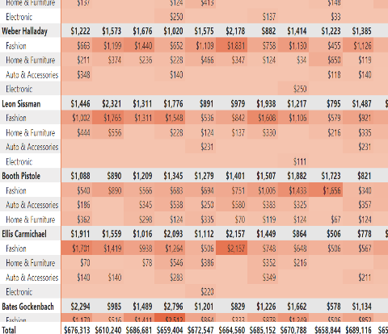
Create Matrix
Step 1: Put Customer Name in Rows.
Step 2: Put Months in Columns
Step 3: Put sales column then click on downward key and select sum on Value option.
Step 4: Go to Format tab, Change Data color by color scale.

Slide 14
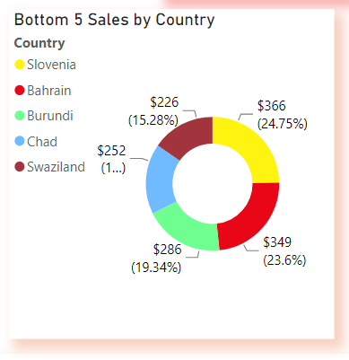
Create Donut Chart
Step 1: Go to field Tab
Step 2: Put Country in Legend
Step 3: Put sales column then click on downward key and select sum on Value option.
Step 4: Go to Format tab, Change Data color by country name.
Step 5: Applied filter to know Bottom 5 sales by country where we have to increase our sales so that we can earn profit

Slide 15
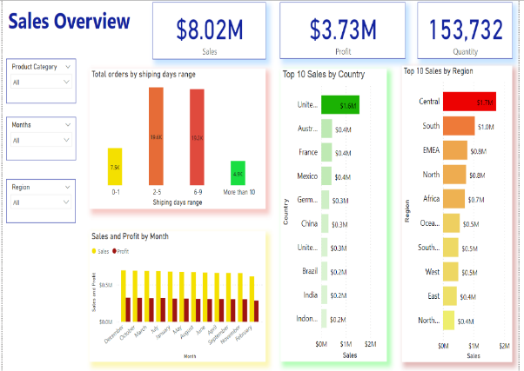
Insights of Sales Overview Dashboard
Product Category wise Sales and Profit.
How many Product sold out by product category
In 2-5 days we delivered 19.6k products.
In December, October month we did maximum sales and we earn maximum profit.
United States, Australia, France etc. are the top 10 countries where we do maximum sales.
In which Region of United States we do maximum sales.

Slide 16
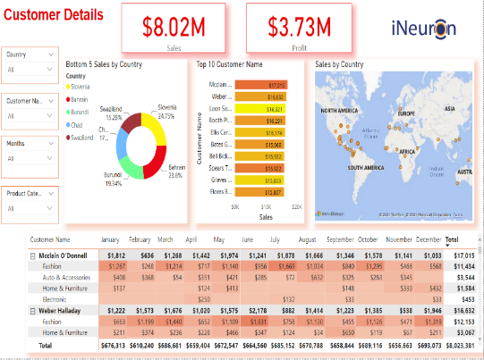
Insights of Customer Details Dashboard
Slovenia, Bahrain, Burundi, Chad and Swaziland are the bottom 5 countries where we get minimum sales revenue.
Mcclain O’Donnell, Weber Halladay, Leon Sissman etc. are the customers who frequently purchase our products.
Mcclain purchases fashion product more than electronic products so as with other customers.
In Electronic we earn $3,94,738 sales revenue which is quiet less in comparison of other category.
Alabania , Peru, Swaziland are some countries where customers hardly purchase our electronic product

Slide 17
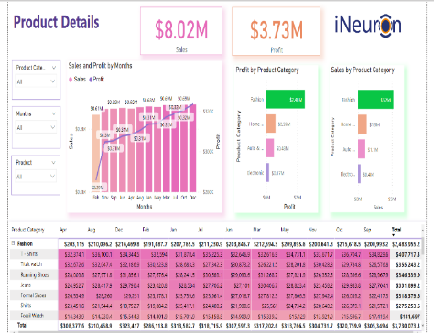
Insights of Product Detail Dashboard
We earn maximum sales revenue from fashion category then Home & Furniture then Auto & Accessories and so on.
After looking Line & Stacked column chart we can see our profit line going upward direction which means the overall sales throughout the year went well.
In fashion Category we earn minimum profit on Suits and Sports Wear products.
In Electronics we earn minimum profit on Speaker, LCD, Mouse, Watch, Keyboard products.
Due to winter season we earn minimum profit on fashion category.

Slide 18
Conclusion
We should work on our Sports wear products because sports wear products is not a seasonal product.
We should work on our electronic products because in electronic we earn least profit
We should send product feedback to those customers who purchases our Electronic products like Gaines O'Carroll, Massey Marley, Barrett Gayman so that we can upgrade them according to the customer feedback.
Sell winter products as well so that we can increase our sale.
Increase our sale in Slovenia, Bahrain, Burundi, Chad and Swaziland country.
For increasing our sales we should do campaign, SEO, Content Writing so that more people will know why our product is best and what are their features.

Slide 19


